Slide 1
Alternatives to Traditional Fitness Testing
Tara B. Blackshear, Ed.D.
Department of Kinesiology
Physical Education Teacher Education
May 3, 2019
Notes:
Introduction

Slide 2
Objectives
Provide a brief overview of fitness testing in schools
Discuss the purpose, challenges, and benefits of fitness testing
Discuss physical activity behaviors among youth
Present fitness testing alternatives
Fitness implementation, tracking & assessments
Notes:
How many of you use fitness test in your PE programs? What are some problems that you have encountered when fitness testing? Students are unclear of the purpose/meaning, turn off students – absent/avoidance

Slide 3
PHYSICAL ACTIVITY, FITNESS & WELLNESS
Photo by bruce mars on Unsplash
Notes:
PE MODEL

Slide 4
HISTORY OF FITNESS TESTING IN PHYSICAL EDUCATION
Collaboration between PE & Military personnel
Health Related Fitness
AAHPERD – Physical Best
Presidential Fitness
The Cooper Institute
PHE Canada
SHAPE America
Canada Fitness
Award Program
Anthropometrics
?
Canadian Forces
& JFK
Mid-1900s
1950s
1966
1992
1994
Late 1800s – early 1900s
1942
1960s
1970
1984
Today
Centennial Athletic
Awards Program
(CAHPER)
Physical efficiency
Athletic Performance
Military preparation
Normative
assessments
Active Living
Challenge Program
Fitnessgram ® & AAHPERD merge
https://www.ncbi.nlm.nih.gov/books/NBK241311/
Notes:
National center for biotechnology

Slide 5
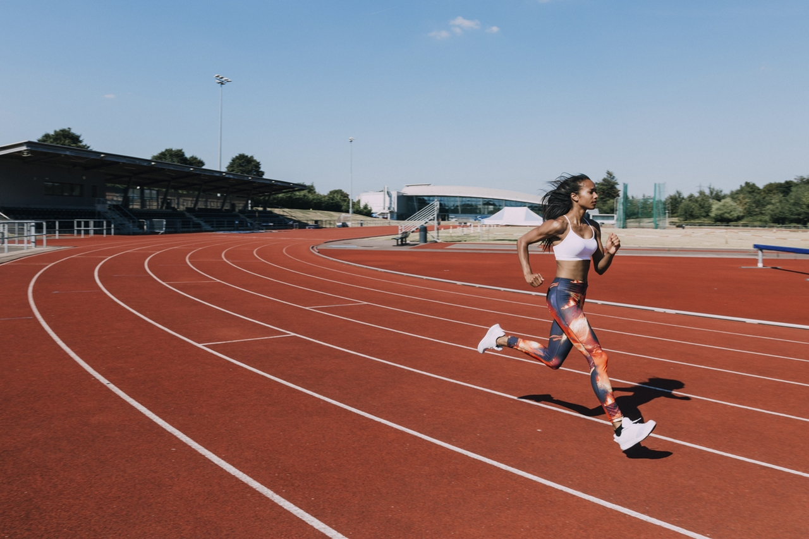
Traditional Fitness Testing
Mile/1600m run
Curl-ups
Push-ups
Sit and reach
Pull-ups/Flexed-Arm Hang
20-meter shuttle run
Broad jump
Vertical jump
50- & 300-yard dashes
Notes:
How many of you are physically active or exercise regularly? Why are you physically active? What inspires you?
So, when you hear ”traditional fitness testing,” what comes to mind?

Slide 6
Traditional Fitness Testing
Cattle call
One size fits all
On display
Humiliation
Boring
Time consuming
Large group
Valid/Reliable (somewhat)
Little to no equipment
Evidence
PFA Measurements
PFA Measurements
PFA Measurements
Queen’s College 3 Minute Step Test
Push-ups
Queen’s College 3 Minute Step Test
3-Site Skinfold
Push-ups
Queen’s College 3 Minute Step Test
3-Site Skinfold
Push-ups
3-Site Skinfold
Abdominal
Curl-ups
YMCA
Sit-and-Reach Test
Abdominal
Curl-ups
YMCA
Sit-and-Reach Test
Abdominal
Curl-ups
YMCA
Sit-and-Reach Test
Notes:
So what are some problems that you have encountered when fitness testing? Students are unclear of the purpose/meaning, turn off students – absent/avoidance

Slide 7
False Sense of Fitness
http://www.ausleisure.com.au/images/sized/images/ausleisure/files/Les_Mills_Born_to_Move_youth-516x320.jpg
http://blog.drstankovich.com/files/2013/06/tired-athlete-.jpg

Slide 8
Physical Activity Guidelines (CSEP)
Notes:
Canadian Society for Exercise Physiology

Slide 10
35 - 37.6%
http://clipart-library.com/canadian-maple-leaf.html
Notes:
ParticipAction
According to the Public Health Agency of Canada, 37.6% of youth meet these guidelines.

Slide 11
D+
Notes:
Canadian children were give a D+ by ParticipACTION

Slide 12
21.6%
http://clipart-library.com/american-flag-clip-art.html
Notes:
According to the CDC and Prevention 21.6% of US children meet the guidelines

Slide 13
D-
Notes:
https://www.physicalactivityplan.org/projects/PA/2018/2018_USReportCard_UPDATE_12062018.pdf?pdf=page-link
Page 8

Slide 14
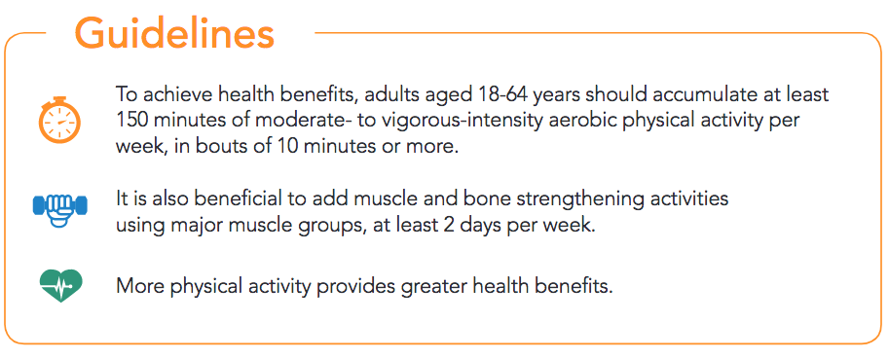
Physical Activity Guidelines (CSEP)
Notes:
http://www.csep.ca/CMFiles/Guidelines/CSEP_PAGuidelines_adults_en.pdf
.

Slide 15
17.6%
http://clipart-library.com/canadian-maple-leaf.html
Notes:
According to the Government of Canada only 17.6% of adults meet this criteria

Slide 16
23.5%
http://clipart-library.com/clipart/american-flag-clip-art-1.htm
Notes:
CDC

Slide 17
Physical Education/PA Requirements
Alberta
Nova Scotia
Saskatchewan
Manitoba
New Brunswick
Newfoundland & Labrador
Prince Edward Island
Quebec
Elementary = 120 minutes/week
Secondary – 2, 75-minutes/week – 3 PE Courses
Ontario
All – Daily PA 20 minutes (100 minutes /week)
Fitnessgram® fitness testing
British Columbia
Required – K-10
PA promotion

Slide 18
Notes:
Goal is to develop physically literate children, but does traditional fitness testing promote this?

Slide 19
Concurrent Training
Aerobic & Anaerobic
Endurance & Strength

Slide 20
Benefits of Concurrent Training

Slide 21
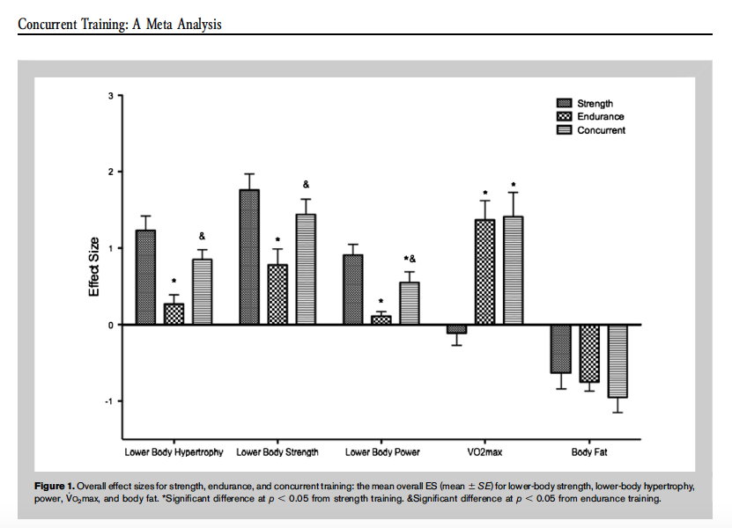
Notes:
Wilson, et al. (2012)

Slide 22
High Intensity Interval Training (HIIT)
Health-Related Fitness Components
Skill-Related Fitness Components
Suitable for all ages and fitness levels
No Equipment needed
Customize/modify

Slide 23
BENEFITS OF HIIT TRAINING
⬆️ VO₂ max
⬇️ Body Composition
⬆️ Health of metabolic diseases
_{Hypertension}
_{Obesity}
_{Coronary artery disease}

Slide 24
HITT Physical Activity Fitness Menus
Beginner
Advanced
Intermediate
Notes:
32 exercises per card

Slide 25
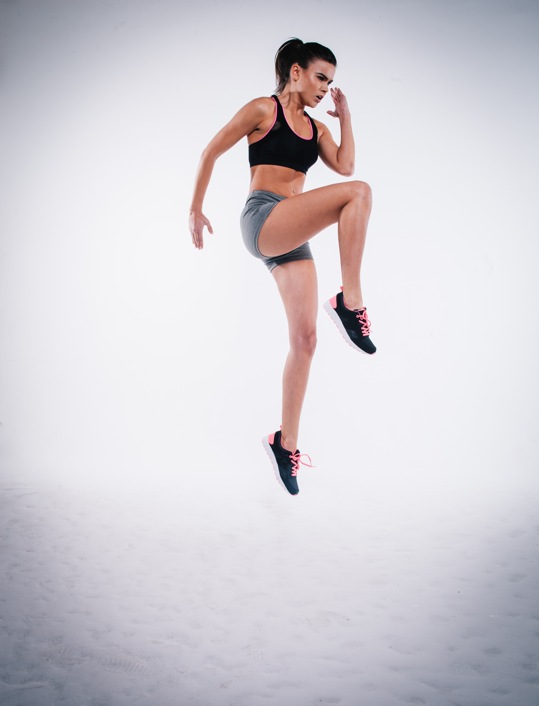
FITNESS MENUS
Beginner
Simple
Low impact
Intermediate
Hi/Lo-impact
Advanced
Compound movements
High impact
Power
Photo by Clem Onojeghuo on Unsplash
Notes:
32 rounds – 20/10 second intervals = 10.67 work/16:00 minutes total
32 rounds – 30/15 second intervals = 16:00 work/24 minutes total
32 rounds – 45/15 second intervals = 24 work/32 minutes total

Slide 26
Integration & Movement Concepts
Technique/Form
FITT Principle
SAID Principle
Muscular Contraction
Joint Movement
Energy Systems
Physiological Adaptations/Response
Notes:
Of movement concepts and assessment

Slide 27
Beginner
KNES 238 HIIT TRAINING
Name ___________________________ |  |  |  | Goal ________________________________________
Date _______________ |  |  |  | Interval ratio work ____ seconds rest ____ seconds
Exercises | # | Exercises | # | Exercises | # | # | Exercises | #
Step Jacks |  | Step Touch |  | ALT Front Leg Raise |  |  | March in Place
Front Jabs |  | Knee Push-ups |  | Lateral Arm Raises |  |  | Fire Hydrants
Step Jacks |  | Step Touch |  | ALT Front Leg Raise |  |  | March in Place
Front Jabs |  | Knee Push-ups |  | Lateral Arm Raises |  |  | Fire Hydrants
Step Jacks |  | Step Touch |  | ALT Front Leg Raise |  |  | March in Place
Front Jabs |  | Knee Push-ups |  | Lateral Arm Raises |  |  | Fire Hydrants
Step Jacks |  | Step Touch |  | ALT Front Leg Raise |  |  | March in Place
Front Jabs |  | Knee Push-ups |  | Lateral Arm Raises |  |  | Fire Hydrants
Reflection:
Notes:
32 rounds – 20 second intervals = 10.67 minutes
32 rounds – 45 second intervals = 24 minutes

Slide 28
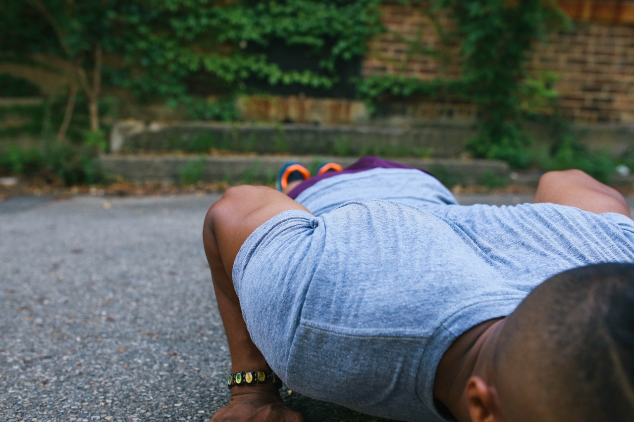
Intermediate

Slide 29
Intermediate
KNES 238 HIIT TRAINING
Name ___________________________ |  |  |  | Goal ________________________________________
Date _______________ |  |  |  | Interval ratio work ____ seconds rest ____ seconds
 | # |  | # |  | # |  | #
High Knees |  | Inchworm + jump |  | Pop Squats |  | In, In, Out, Out
Push-up Jacks |  | Jumping Jacks |  | Front Jabs |  | X-Mountain Climbers
High Knees |  | Inchworm + jump |  | Pop Squats |  | In, In, Out, Out
Push-up Jacks |  | Jumping Jacks |  | Front Jabs |  | X-Mountain Climbers
High Knees |  | Inchworm + jump |  | Pop Squats |  | In, In, Out, Out
Push-up Jacks |  | Jumping Jacks |  | Front Jabs |  | X-Mountain Climbers
High Knees |  | Inchworm + jump |  | Pop Squats |  | In, In, Out, Out
Push-up Jacks |  | Jumping Jacks |  | Front Jabs |  | X-Mountain Climbers
Reflection:

Slide 30
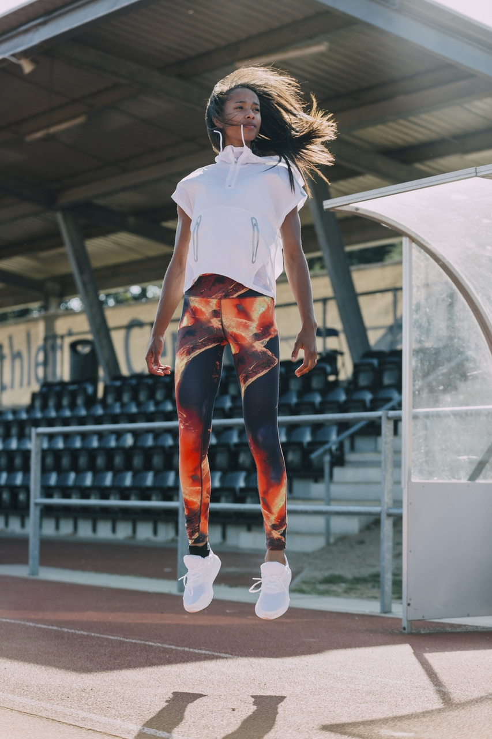
Advanced

Slide 31
Advanced
KNES 238 HIIT TRAINING
Name ___________________________ |  |  |  | Goal ________________________________________
Date _______________ |  |  |  | Interval ratio: work ____ seconds rest ____ seconds
Exercises | # | Exercises | # | Exercises | # | Exercises | #
Burpees |  | Mountain Climbers |  | Alternating Power Lunges |  | Dips
Jump Squats |  | POWER Jacks |  | Push-up Jacks |  | Power Kicks
Burpees |  | Mountain Climbers |  | Alternating Power Lunges |  | Dips
Jump Squats |  | POWER Jacks |  | Push-up Jacks |  | Power Kicks
Burpees |  | Mountain Climbers |  | Alternating Power Lunges |  | Dips
Jump Squats |  | POWER Jacks |  | Push-up Jacks |  | Power Kicks
Burpees |  | Mountain Climbers |  | Alternating Power Lunges |  | Dips
Jump Squats |  | POWER Jacks |  | Push-up Jacks |  | Power Kicks
Reflection:
 |  |  |  |  |  |  | )

Slide 32
CHOICE

Slide 33
KNES 238 HIIT TRAINING
Name __________________________ |  |  |  |  | Goal ____________________________________
Date ________ |  |  |  |  | Interval Ratio: work ____ seconds rest ____seconds
 | #/HR/Time |  |  | #/HR/Time |  | #/HR/Time | #/HR/Time |  | #/HR/Time | #/HR/Time
High Knees |  | Choice |  |  | Pop Squats |  |  | Choice
Choice |  | Jumping Jacks |  |  | Choice |  |  | X-Mountain Climbers
High Knees |  | Choice |  |  | Pop Squats |  |  | Choice
Choice |  | Jumping Jacks |  |  | Choice |  |  | X-Mountain Climbers
High Knees |  | Choice |  |  | Pop Squats |  |  | Choice
Choice |  | Jumping Jacks |  |  | Choice |  |  | X-Mountain Climbers
High Knees |  | Choice |  |  | Pop Squats |  |  | Choice
Choice |  | Jumping Jacks |  |  | Choice |  |  | X-Mountain Climbers
Reflection:
 |  |  |  |  |  |  |  | Blackshear, T. B. (2019)

Slide 34
KNES 238 HIIT TRAINING
Name __________________________ |  |  |  |  | Goal ____________________________________
Date ________ |  |  |  |  | Interval Ratio: work _____ seconds rest _____ seconds
Exercises | #/HR/Time | Exercises |  | #/HR/Time | Exercises | #/HR/Time | #/HR/Time | Exercises | #/HR/Time | #/HR/Time
Reflection:
 |  |  |  |  |  |  |  | Blackshear, T. B. (2019)

Slide 35
On-going Formative Assessment

Slide 36
(Alternative) Summative Fitness Assessments
5 Exercises
1-2 minute rounds
The Candidate
Shaun T’s Insanity Fit Test
X-Training
500 m Run
40 Squat Jumps
30 Curl-ups
20 Push-ups
7-minute workout
Advanced 7-minute workout
7-minute App/Website
Darbee/Neila Rey

Slide 37
STUDENT REFLECTION
1. Were you happy with your OVERALL results? Were there tests with which you were not happy? Why? Were there tests with which you were pleased? Why?
2. For each of the fitness tests, in which Fitness Health Zone does it place you? Beginner, Intermediate, Advanced? or Level A, B, C?
3. Comment about how you were feeling while you were completing the fitness tests – both physically and mentally (What were your thoughts while completing the fitness tests?).
4. What contributed to your scores, either positively or negatively?
5. What do you think may help you to achieve a better score on subsequent fitness tests?
Notes:
Adapted from the International School Bangkok

Slide 38
Alternative Fitness Testing
Modifiable
Customizable
No equipment needed
Short & sweet
⬆️ Physiological response
More effort
On-going assessment/reflection
Transportable
Student Accountability
⬆️ Understandings of Fitness Concepts
Lacks Standardization
Lacks Validity/Reliability (somewhat)
PFA Measurements
PFA Measurements
PFA Measurements
Queen’s College 3 Minute Step Test
Push-ups
Queen’s College 3 Minute Step Test
3-Site Skinfold
Push-ups
Queen’s College 3 Minute Step Test
3-Site Skinfold
Push-ups
3-Site Skinfold
Abdominal
Curl-ups
YMCA
Sit-and-Reach Test
Abdominal
Curl-ups
YMCA
Sit-and-Reach Test
Abdominal
Curl-ups
YMCA
Sit-and-Reach Test

Slide 39
Valid? Reliable?

Slide 40
EDUCATIONAL VALIDITY
WHAT’S THE GOAL?

Slide 41
HIIT
Physical Literacy
Fitness Tracking

Slide 42
Reflects real world physical activities
Short
&
Sweet
Empowers Students
Easy ongoing assessment
Can be used anywhere
Complements traditional
fitness testing
< 11 minutes
< 25 minutes
No equipment needed
Notes:
In summary

Slide 43
THANKS!
Any questions?
You can find me at
tblackshear@towson.edu
#tarablackshear
www.tarablackshear.com

Slide 44
REFERENCES
Barker, J. (2012, September). Fitness: The ABCs of physical education. Retrieved at http://www.montrealgazette.com/health/Fitness+ABCs+physical+education/7202129/story.html
British Columbia Ministry of Education Physical Education 8 – 10. Retrieved at https://www2.gov.bc.ca/assets/gov/education/.../physicaleducation/2008pe810.pdf
Costigan, S. A., Eather, N., Plotnikoff, R. C., Taeffe, D. R., Lubans, D. R. (2015). High-intensity interval training for improving health-related fitness in adolescents: a systematic review and meta analysis. British Journal of Sports Medicine, 49(19), 1253-1261.
Cale, L. & Harris, J. (2009). Fitness testing in physical education – a misdirected effort in promoting
healthy lifestyles and physical activity? Physical Education and Sport Pedagogy
Center for Disease Control and Prevention (2018) CDC Health Schools: Physical Activity Facts. Retrieved at https://www.cdc.gov/healthyschools/physicalactivity/facts.htm
Center for Disease Control and Prevention (2017). National Center for Health Statistics. Exercise or Physical Activity. Retrieved at https://www.cdc.gov/nchs/fastats/exercise.htm
Darbee workout cards.Retrieved at https://darebee.com/workout-cards.html
Healthy Schools Daily Physical Activity in Schools Grades 7 and 8 (2005). Retrieved at http://www.edu.gov.on.ca/eng/teachers/dpa7-8.pdf

Slide 45
REFERENCES CONT’D
Keating, X. D. & Silverman, S. (2009). Teachers’ use of fitness tests in school-based physical education programs. Measurement in Physical Education and Exercise Science, 8(3),145–165. https://doi.org/10.1207/s15327841mpee0803_2
National Physical Activity Plan Alliance. The 2018 United States Report Card on Physical Activity for Children and Youth. Washington, DC: National Physical Activity Plan Alliance, 2018.Retrieved at https://www.physicalactivityplan.org/projects/PA/2018/2018_USReportCard_UPDATE_12062018.pdf?pdf=page-link
Ontario Health and Physical Education Curriculum (2016, November 4). Retrieved at https://settlement.org/ontario/education/elementary-and-secondary-school/school-systems-in-ontario/ontario-health-and-physical-education-curriculum/
ParticipACTION (2018). Retrieved at https://www.participaction.com/en-ca/resources/report-card
Public Health Agency of Canada (2017). At-a-glance: Physical activity sedentary behviour and sleep (PASS) indicator framework Retrieved at https://www.canada.ca/en/public-health/services/reports-publications/health-promotion-chronic-disease-prevention-canada-research-policy-practice/vol-37-no-8-2017/at-a-glance-physical-activity-sedentary-behaviour-sleep-indicator-framework.html

Slide 46
REFERENCES CONT’D
Reynolds, G. (2014, October 24). The advanced 7-minutue workout. Retrieved at
https://well.blogs.nytimes.com/2014/10/24/the-advanced-7-minute-workout/
Silverman, S., Keating, X. D., & Phillips, S. R. (2008). A lasting impression: A pedagogical perspective on
youth fitness testing. Measurement in Physical Education and Exercise Science
Wilson, J. M., Marin, P. J., Rhea, M. R., Wilson, S. M. C., Loenneke, J. P., & Anderson, J. C. (2012).
Concurrent training: A meta-analysis examining interference of aerobic and resistance exercises.
Journal of Strength and Conditioning Research, 26(8), 2293-2307.
World Health Organizaiton (n.d.) Global strategy on diet, physical activity and health: Physical activity and
adults. Retrieved at https://www.who.int/dietphysicalactivity/factsheet_adults/en/
World Health Organization (n.d.) Global strategy on diet, physical activity and health: Physical activity and
young people. Retrieved at https://www.who.int/dietphysicalactivity/factsheet_young_people/en/

